Slide 1
1.Find a problem worth solving, analyzing, or visualizing.
Cost share ( Python Pandas)
Risk prediction ( ML)
Labor hours, and flow data analysis
Visualization with Tableau
2.Use machine learning (ML) with the technologies we’ve learned.
3.You must use Scikit-learn and/or another machine learning library.
3.Your project must be powered by a dataset with at least 100 records.
You must use at least two of the following:
Python Pandas
Python Matplotlib
HTML/CSS/Bootstrap
JavaScript Plotly
JavaScript Leaflet
SQL Database
MongoDB Database
Google Cloud SQL
Amazon AWS
Tableau
For this project, you can focus your efforts within a specific industry, as detailed in the following examples

Slide 2
Water Sector
Create an algorithm that analyzes risk score and predicts pipe segment
Using natural language processing, create a chatbot to perform simple tasks and help users find information.
Train an algorithm to analyze consumer spending and predict trends.
Train an image classifier to assess property value, which could then be used to calculate insurance quotes.

Slide 3
SQL
Leaflet
Flow per user
Python Pandas
Introduction
Flow
and cost analysis
User Cost Share
Cost Impact of Collapse
SQL
Labor Hour Per Location
Tableau
Visualization
ML
ML
ML
Pipe Condition
Pipe Risk Score
Predict Collapse

Slide 4
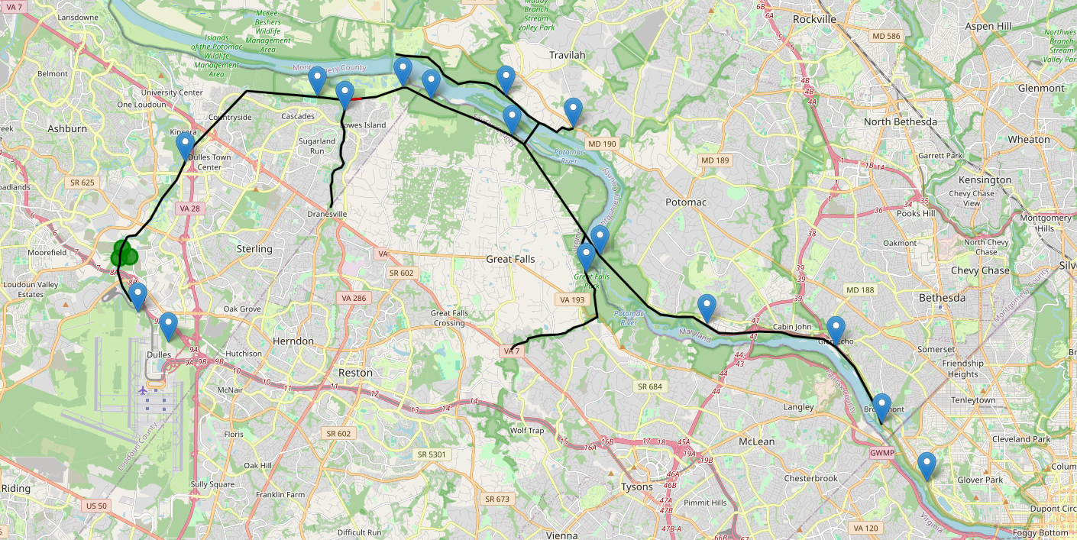

Slide 5
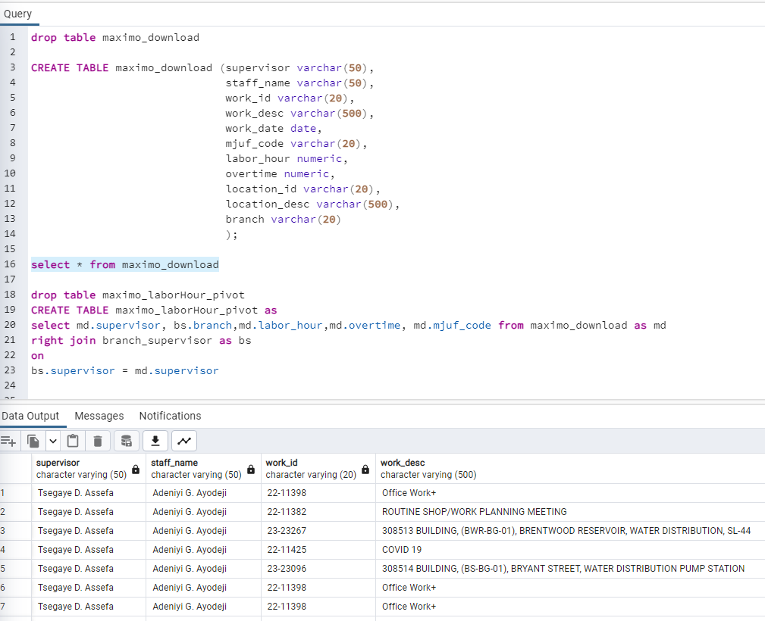

Slide 6
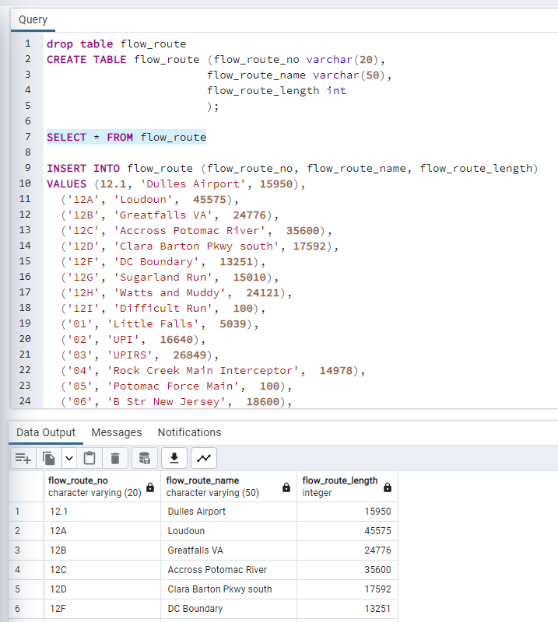

Slide 7
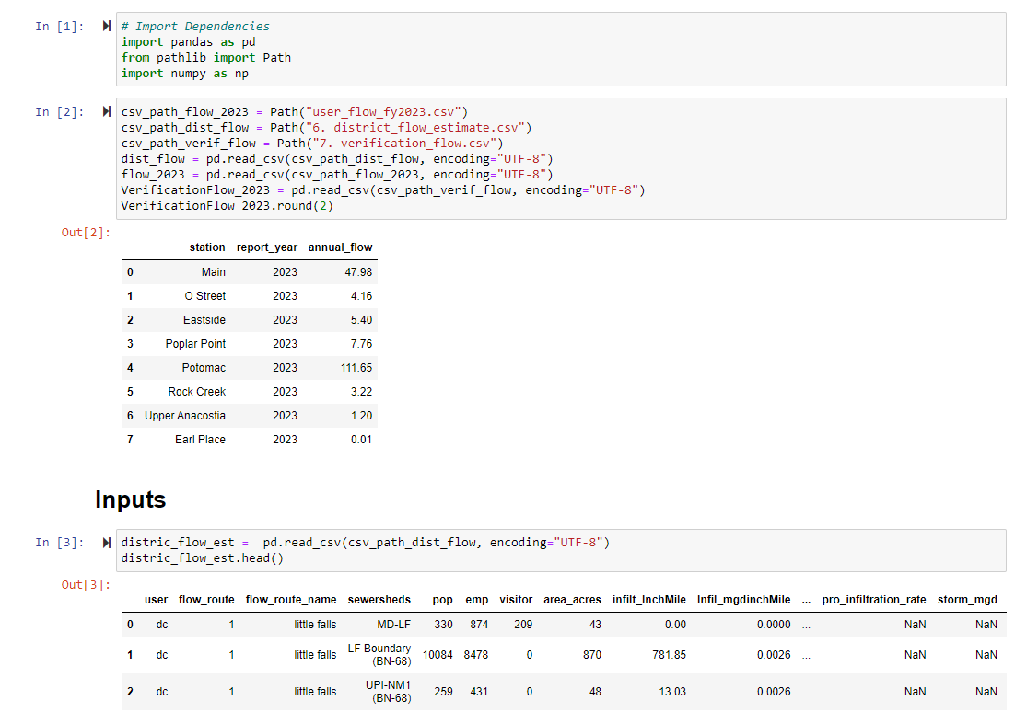

Slide 8
